Slide 1
Overview of the Money Follows the Person Demonstration Relaunch
ASAP Network
Executive Office of Health and Human Services
July 2023
Confidential - for policy development purposes only

Slide 2
What is the Money Follows the Person Demonstration?
The Money Follows the Person Demonstration (MFP Demo) is a federally funded grant that covers services that help people with disabilities and older adults to move from qualified nursing facilities and long term stay hospitals to qualified residences in the community.
As of April 27, 2023, MassHealth received approval from Centers for Medicare and Medicaid Services (CMS) on our Operational Protocol Document (OPD) Addendum which allows MassHealth to move forward with MFP Demo implementation.

Slide 3
Background
Money Follows the Person is a Demonstration Grant from the Centers for Medicare and Medicaid Services (CMS) awarded to MassHealth
The original Massachusetts Money Follows the Person Demonstration (MFP Demo) ran from April 2011 through June 2018.
  Over 3,100 individuals signed up for the MFP Demo.
  2,151 individuals successfully transitioned to the community.
Notes:
We will get into the approach at the end

Slide 4
Why is Massachusetts relaunching the MFP Demo?
The federal government has new funding to offer to states to relaunch their MFP Demonstrations.
The MFP Demo provides Massachusetts with funding that expands our ability to serve more individuals as they transition out of facilities.
We can offer a set of services that would not otherwise be available to individuals as they transition out of facilities.
The MFP Demo funding can enhance our ability to provide outreach and identify individuals who might be interested in transitioning out of facilities.

Slide 5
MFP Demo – How does it work?
Using our existing outreach and enrollment mechanisms, we will enroll individuals who are eligible for MassHealth Standard or CommonHealth in the MFP Demo after a facility stay of 60+ days.
We can serve individuals in the MFP Demo who are not eligible for waivers and offer them services they would not otherwise have access to, such as transitional assistance and home modifications.
We may also enroll waiver-eligible individuals in the MFP Demo, in order to take advantage of the additional federal funding associated with the MFP Demo. In these cases, the individual is enrolled in both a waiver and the MFP Demo.

Slide 6
MFP Demo target populations
CMS establishes broad target populations* for the MFP Demo:
  Elders
  Individuals with Intellectual/Developmental Disabilities (ID/DD)
  Individuals with Physical Disabilities
  Individuals with Mental Illness
* These are the terms that CMS uses for these populations.

Slide 7
MFP Demo projected transitions
The following table shows the projected target populations that have been approved by CMS.
Projected Transitions | CY 2023 | CY 2024 | CY 2025 | CY 2026
Elders | 276 | 276 | 276 | 276
ID/DD | 6 | 6 | 6 | 6
Physically disabled | 278 | 278 | 278 | 278
Mental illness | 40 | 40 | 40 | 40
TOTAL: | 600 | 600 | 600 | 600

Slide 8

MFP Demonstration - Workflow
MFP Demo Qualified Residences
Individual’s/ Family’s Home
Individual’s Leased Apartment
Community Residential Setting (Max 4 Individuals)
Assisted Living Residences
MFP Demo
participants may access
services in the community through:
  HCBS Waivers (ABI/MFP, Frail Elder, DDS ID)
  One Care/SCO/PACE
  MassHealth State Plan services
MFP Demo Qualified Facilities
Nursing Facilities
Rehab & Chronic Hospitals
ICF-ID
DPH Hospitals
Psychiatric Hospitals - with some exceptions
MFP Demo transition
services & supports

Slide 9
MFP Demo Services
Transitional Assistance (TA)
Assistive Technology (AT)
Community Engagement Navigation (CEN)
Case Management

Slide 10


Transitional Assistance (TA)
Non-recurring set-up expenses and short-term services necessary to
facilitate an individual's transition from a facility-based long term care setting to the community. (Note: not an all-inclusive list)
Goods and Services:
  Moving expenses
  First month’s rent*
  Security deposit*
  Utility set up fees/deposits
  Pest eradication*
  One-time cleaning prior to occupancy*
  Televisions up to 36”
  Furniture, window coverings, linens
  Home modifications
  Washer/dryer*
* May not apply to residential settings
Notes:
These do not all apply to residential settings
MFP Demonstration Transitional Assistance (TA) service allows a broader array of goods and services than what is available through Waiver Transitional Assistance Service.
If the waiver does not cover a specific good or service, such as first month’s rent, it can be obtained through MFP Demo TA.

Slide 11
Assistive Technology (AT)
Devices, controls, or appliances that enable individuals to increase their ability to perform activities of daily living; or that enable individuals to perceive, control, or communicate with the community environment in which they live, thereby promoting community integration.
Individuals that are enrolled in the MFP Demonstration may be eligible for AT.
Services
Evaluations necessary for the selection, design, fitting or customization of AT to meet the needs of the individual
Customization, adaptation, fitting, set-up, maintenance or repairs of AT
Temporary replacement of AT
Training or technical assistance with the use of AT
Acquisition of cell phones, tablets, computers and ancillary equipment necessary for the operation of devices that enable the participant to engage in telehealth
Notes:
Assistive Technology is similar to Specialized Medical Equipment as defined under the ABI and MFP Home and Community-based Services Waivers.

Slide 12
Community Engagement Navigation (CEN)
A “bridge” service that would include accompaniment and transportation from facilities to community housing and service options provided by CEN provider staff.
Note: All services must be authorized by a case manager/service coordinator before received.
Community Engagement Navigation (CEN) | Transitional Assistance (TA) Services
Following a signed informed consent, CEN services can be provided at any time prior to transition | Provided no more than 60 days prior to transition
Primary focus is community exploration before transition | Primary focus is on the immediate need for services and supports to assist in the transition
Assist individuals in identifying and engaging in a variety of community settings and services | Provide housing search for individuals in need of a safe and accessible residence. This service can be provided at any point prior to transition
Accompanying individuals in visiting community housing, day programs, community centers | Accompanying individuals in visiting specific identified housing options
CEN can be provided pre and post transition | TA is focused on pre-transition services and supports
Notes:
Establish links to the community

Slide 13
MFP Demo Case Management/Service Coordination
These are some examples of case management/service coordination duties.
Supports and assists all enrolled individuals transitioning into the community and participants post transition
Provides information about the range of community-based services, supports and housing options.
Facilitates a person-centered planning process which includes identifying housing options, determining, arranging and authorizing services needed to ensure a safe transition.
Conducts a risk assessment and works with the individual to develop an appropriate back-up plan, responsive to the individuals needs and risks.
Monitors back-up plan and service provisions and adjusts as needed for 365 days in the community

Slide 14
Referral sources
Begin with a soft launch approach and focus on individuals who have currently applied for or are eligible for Home and Community Based Service Waivers.
Integrate the MFP Demo program into existing outreach and identification activities to educate:
  Staff at qualified facilities (i.e., social workers, admission/discharge planners)
  State agencies
  Aging & Disability Resource Consortia (ADRC) Network
  Aging Service Access Point (ASAP) staff
      Community Transition Liaison Program (CTLP), Options Counselors, nurses, information and referral staff
  Independent Living Centers (ILC) Staff
      Options counselors, transitions staff, housing coordinators, information and referral staff

Slide 15
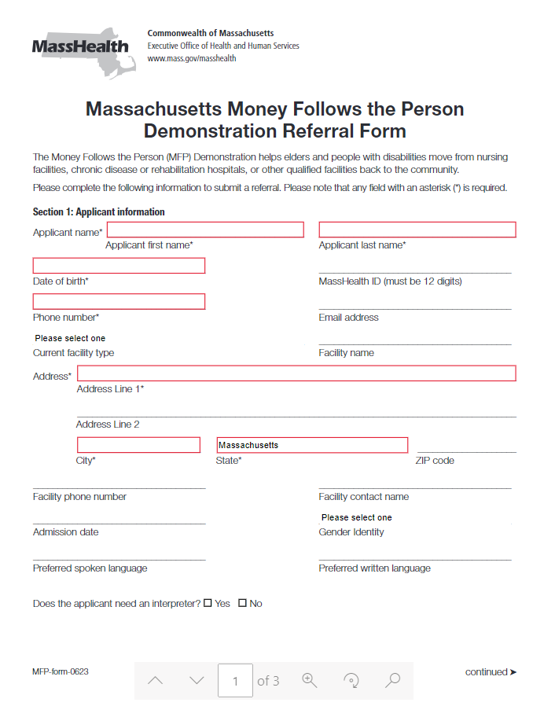
Referral form

Slide 16
MFP Demo – Participation
Participation is voluntary.
An individual may remain enrolled in the MFP Demo for a period of 365 days post discharge. After that time, the individual’s MFP Demo enrollment and services end. The individual will continue to receive MassHealth State Plan, HCBS Waiver services, and/or State Home Care if eligible.
Case management services will be provided by the following:
  ASAP for those eligible for Frail Elder Waiver (FEW) or State Home Care
  DDS for those eligible for ABI/MFP residential waivers, ID waivers or DDS funded services
  MRC for those eligible for ABI/MFP community waivers, State Plan, and all others

Slide 17
MFP Demo- Informed Consent

Slide 18
MFP Demo – ASAP Roles and Responsibilities
  Pre-transition tasks:
  Integrate the MFP Demo into existing outreach and identification activities and planned CTLP outreach and identification activities.
  Identify individuals for the MFP Demo who are currently and/or potentially eligible for HCBS waivers, State Funded Home Care, or MassHealth LTSS.
  Support ongoing education and training about the MFP Demo with all ASAP staff, including CTLs, Options Counselors, nurses, case managers, and information and referral staff.
  Obtain a signed MFP informed consent form from the individual or their legal representative. Maintain a copy of the signed MFP informed consent form in the individual’s case record;
  Enroll individuals in the Money Follows the Person Information System (MFP-IS).

Slide 19
MFP Demo – ASAP Roles and Responsibilities
  Post-transition tasks:
  Provide case management and transitional assistance for MFP Demo enrollees eligible for FEW, State Home Care.
  Document, track and maintain an individual’s record in MFP-IS to include:
      transition to a qualified community setting;
      completion date of risk assessment and 24/7 back-up plan;
      case management and/or guardianship changes;
      hospital/nursing facility readmissions;
      enrollment status changes; and
      365-day MFP demo participation completion.

Slide 20
MFP Demo – Proposed financial model
ASAP CM Responsibilities | *Total Time | **Hourly Rate | One-time payment
Pre-transition tasks | 5 hours | $50 | $250
Post-transition tasks | 10 hours | $50 | $500
* | Time estimates reflect additional MFP Demonstration tasks only and do not include activities included in the current ASAP case management responsibilities.
** | Rate developed using CH257 BLS Benchmark Proposed Regulations: Supporting Materials | Mass.gov plus tax, fringe, and overhead

Slide 21
Community Programs Serving MFP Demo Participants
Moving Forward Plan Waivers
Frail Elder Waiver and State Home Care for Elders
Money Follows the Person
Demonstration Participation
(365 Community Days)
Acquired Brain Injury Waivers
DDS Waivers
One Care
and PACE
MassHealth Long Term Services and Supports
Senior Care Options (SCO)
ACO and
MCO

Slide 22
MFP Demo next steps – Project Office Team
  Outreach and provide ongoing communication, education and training about the MFP Demo and MFP-Information System (MFP-IS)
  Distribute the Informed Consent Form to case managers
  Finalize and share:
    MFP Demo website
    MFP Demo brochure and fact sheet
Contact Information
  John Garcia, Project Director
  Jennifer Reid, Assistant Project Director
  Eileen Gammetto, Operations and Eligibility Manager
Email: mfpprojectoffice@mass.gov
Phone: (617) 573-1647

