Slide 1
Overview of the Massachusetts Department of Mental Health

Slide 2
Commonwealth Mental Health Authority
Serves approximately 29,000 individuals every year
Employs 3,300 staff
Annual operating budget of $1B.
Operates and procures services for both Adults and Children/families

Slide 3
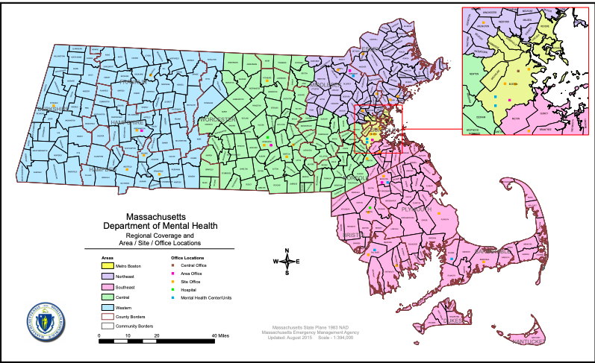
5 Geographic Areas across Massachusetts
North-eastern Mass (NEA)
Metro Boston (MBA)
Western Mass (WMA)
Central Mass (CMA)
South-eastern Mass (SEA)

Slide 4
DMH Serves two primary roles
Serving
Serving as the Commonwealth’s Mental Health Authority
Delivering specialized services for adults and children with the most serious behavioral health needs
Delivering

Slide 5
As the Commonwealth’s Mental Health Authority, DMH:
Licenses inpatient psychiatric units, IRTP, community crisis stabilization and adult residential programs;
Promulgates guidance on standards of care and current best practices;
Provides expert consultation to sister state agencies and government leaders;
Implements capacity-building initiatives in the mental health provider sector.

Slide 6
Mental Health Services at Mass DMH
DMH provides specialized services for children, youth and adults with the most serious mental health needs.
The Department of Mental Health (DMH) provides supports and services that complement those provided by other agencies or systems (commercial insurance, MassHealth, other state agencies such as DCF, schools, community programs, etc.)

Slide 7
DMH
Specialized
Services
Urgent BH Response and Coordination
Behavioral Health Access Points

Slide 8
Behavioral Health Access Points
Behavioral Health Help Line: The 24/7 Help Line is a single, insurance-blind, multi-channel entry point for Commonwealth residents in search of culturally responsive mental health and substance use disorder services.
Community Behavioral Health Centers: Hubs of coordinated and integrated mental health and substance use disorder treatment for MassHealth members of all ages
Recovery Learning Communities: Peer support networks providing community-based and virtual support resources
Young Adult Access Centers: Peer support services that promote social opportunities and access to a range of resources for housing, education, employment
Family Support Programs: Parent support and advocacy

Slide 9
Urgent Behavioral Health Response and Coordination
DMH Critical Needs Case Management
Emergency Department Diversion Programs
Community Mobile and Site-based Respite
Safe Haven and other homeless support services

Slide 10
Community-Based Services
Facility-Based Treatment
Specialized Services for Children, Youth and Families
Case Management
Flexible Support Services
Day Services
Intensive In-Home Treatment
Therapeutic Group Care
Young Adult Staffed and Supported Apartments
Program for Assertive Treatment for Youth
Adolescent Continuing Care Units
Intensive Residential Treatment
Clinically Intensive Residential Treatment

Slide 11
Community-Based Services
Facility-Based Treatment
Specialized Services for Adults
Case Management
Adult Community Clinical Services
Respite
Clubhouse
Program for Assertive Treatment (PACT)
Homeless support services
Adult Continuing Care Units
Recovery from Addictions Program (RAP) – Section 35
Clinic-Based Treatment
Outpatient Services (Boston & Southeast)

Slide 12
Court Clinics
Facility-Based Treatment
Specialized DMH Forensic Services
Adult Court Clinics
Juvenile Court Clinics
Specialty Court Clinics
Specialized clinicians to respond to court-ordered evaluation
Community Based Services
Jail/Arrest Diversion
Forensic Transition Team

Slide 13
When should someone apply for DMH Specialized Services?
When an individual and their family:
Are living with a serious mental illness; and
the needs are not met by current resources
(commercial insurance, MassHealth, or other state agencies, e.g. DCF, schools, community programs, etc.)

Slide 14
Accessing DMH Specialized Services
Clinical Determination
Confirm that the person has a qualifying diagnosis*;
Identify urgent needs; and
Support navigation to other needed resources.
*Qualifying diagnoses include: Schizophrenia and other psychotic disorders, Major Mood Disorders, Anxiety Disorders, Dissociative Disorders, Eating Disorders, Borderline Personality)
Determine functional impairment in multiple domains due to qualifying diagnosis*
*For youth must have a serious emotional disturbance which is the primary cause of the functional impairment
Establish duration-has lasted for at least one year or is expected to last one year

Slide 15
Accessing DMH Specialized Services
Needs and Means
Identifies the specialized services that the person needs and
Confirms that these needs can’t be met by other available resources

Slide 16
!
Questions?
?

Slide 17
Resources
Contact Information by Area
Program and Service Descriptions
Links to other DMH Resources

